Slide 1


Department of Artificial Intelligence and Machine
Learning
Crafting a Secure and Seamless Future with Facial Recognition
Artificial Intelligence Mini Project

Slide 2

INDEX
1
Introduction
2
Principle
3
Features,
4
Code and Sample Output
5
Applications
6
Conclusion

Slide 3
Introduction
A face recognition model is a computer-based system designed to identify and verify individuals by analyzing and comparing facial features from images or video frames. It falls under the broader category of biometric technology, leveraging unique facial characteristics to distinguish one person from another. The process involves capturing or inputting facial data, extracting relevant features, and using a trained model to make predictions or matches.
Key Components and Processes of a Face Recognition Model:
Data Collection Feature Extraction Face Encoding Database Management
Recognition Process
Matching and Decision Making
* Output

Slide 4
Principle
This face recognition model adheres to fundamental software engineering principles, emphasizing modularity, abstraction, and encapsulation. Through the use of a class structure, the code encapsulates the management of known face encodings, names, and the frame resizing factor, promoting a modular and organized design. Abstraction is achieved by encapsulating the internal workings of face recognition within the class, allowing users to interact with a high-level interface. The inclusion of error handling mechanisms enhances robustness, providing informative feedback in the face of unexpected situations. Flexibility is prioritized, allowing users to set the frame resizing factor during object initialization to accommodate diverse use cases.

Slide 5
Principle
The code maintains readability through the inclusion of comments, fostering understanding, and facilitating future modifications. Embracing simplicity, the code offers a straightforward implementation for a basic face recognition system, ensuring ease of use and debugging. Compatibility with established libraries, such as face_recognition and OpenCV, aligns with the compatibility principle, promoting seamless integration into various environments. The feedback mechanism, conveyed through print statements, enhances user understanding of the system's state. Collectively, these principles contribute to the code's effectiveness, reliability, and maintainability, laying a foundation for further development and expansion.

Slide 6
Features
Face Recognition Initialization: The class initializes with empty lists for known face encodings and known face names.
Frame Resizing: The frame resizing factor is used to resize frames for faster face recognition . Image Loading: The load_encoding_images method loads images from a specified path, extracts face encodings, and associates them with the corresponding file names.
Face Detection:The detect_known_faces method takes a frame as input, resizes it, and detects faces using the face_recognition library
Face Encoding Comparison: The code compares the face encodings of detected faces with the
known face encodings using the face_recognition.compare_faces method.
Best Match Selection: It selects the best match based on the smallest distance between face encodings using np.argmin and updates the recognized face name suitably.

Slide 7
Features
Error Handling: Basic error handling is implemented with print statements to notify and handle potential errors during image loading and face detection.
Flexibility: The class allows flexibility in setting the frame resizing factor when initializing the object.
Basic User Feedback: Print statements provide feedback on the number of encoding images
loaded.
Usability: The class provides a simple interface for loading known face encodings and detecting faces in frames.
Compatibility: The code uses the popular face_recognition and OpenCV libraries, making it
compatible with various environments.
Documentation: The code includes comments to explain the purpose of methods and code blocks.

Slide 8
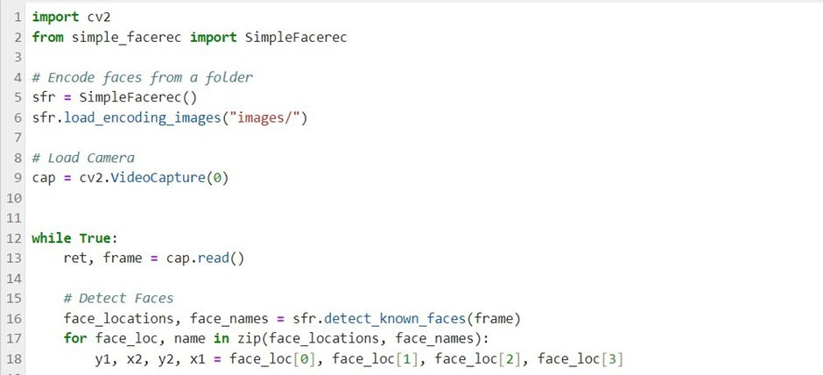
Code

Slide 9
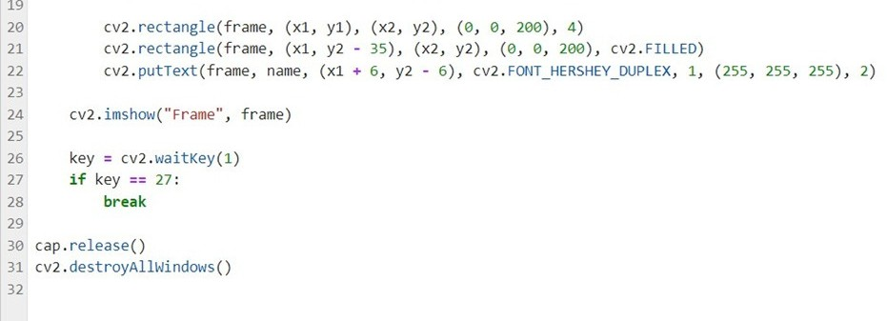

Slide 10
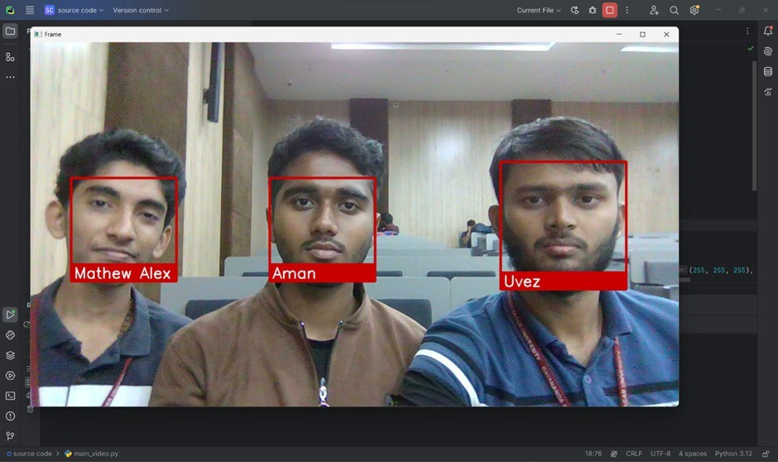
Sample Output- I

Slide 11
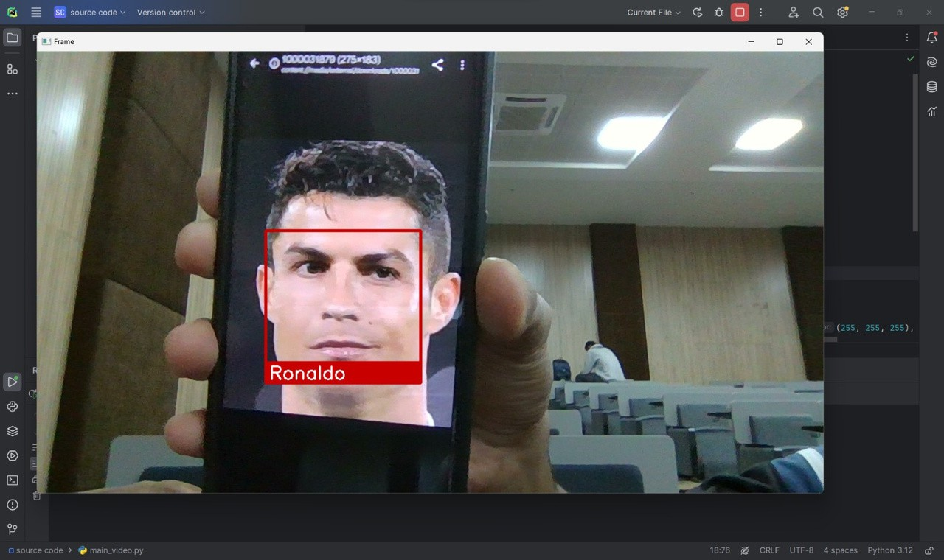
Sample Output- II

Slide 12
Applications
Access Control and Security:
Implement face recognition for secure access to buildings, rooms,or computer systems.Enhance traditional security systems by integrating facial recognition for more robust authentication
Attendance Tracking:
Streamline attendance management in educational institutions or workplaces by using face recognition for automated attendance tracking.

Slide 13
Applications
Access Control and Security:
Integrate face recognition as a biometric authentication method for smartphones, computers, or online platforms, providing a more secure and convenient login experience.
Customer Verification in Banking and Finance:
Utilize face recognition for customer identity verification in banking and financial institutions, reducing the risk of fraud and enhancing account security.

Slide 14
Applications
Retail Analytics:
Implement facial recognition to analyze customer demographics and behavior in retail environments, enabling targeted marketing strategies and improving customer experiences.
Law Enforcement and Public Safety:
Assist law enforcement agencies in identifying and tracking
individuals in public spaces, aiding in the prevention and investigation of criminal activities.

Slide 15
Applications
Healthcare:
Enhance patient identification and streamline hospital workflows by using face recognition in healthcare settings.
Airport Security:
Improve airport security by integrating facial recognition for identity verification in passport control and boarding processes.

Slide 16
Applications
Human Resource Management:
Facilitate HR processes by using face recognition for candidate interviews, employee attendance tracking, and monitoring employee access to secure areas.
Smart Cities:
Contribute to the development of smart city infrastructure by
implementing face recognition for public safety, traffic management, and personalized services.

Slide 17
Conclusion
In conclusion, the process of creating and deploying the facial recognition system has not only shown off artificial intelligence's amazing potential but also shown how useful it can be in improving ease and security. Our model's efficiency and accuracy demonstrate the progress made in computer vision and machine learning.
Upon reflection on the work completed on this short project, it is clear that facial recognition is becoming more than just a science fiction concept—it is a real technology with a wide range of practical uses. The ramifications are wide-ranging and significant, ranging from protecting sensitive regions to expediting user verification procedures.

Slide 18



THANK YOU
End of the Presentation
Prepared By
Mohammed Uvez Khan
USN: ENG22AM0019
Aman Ramzan Sheikh
USN: ENG22AM0003
Mathew Alex
USN: ENG22AM0113

